Slide 1
Model Selection (2)
Noise Filtering Part

Slide 2
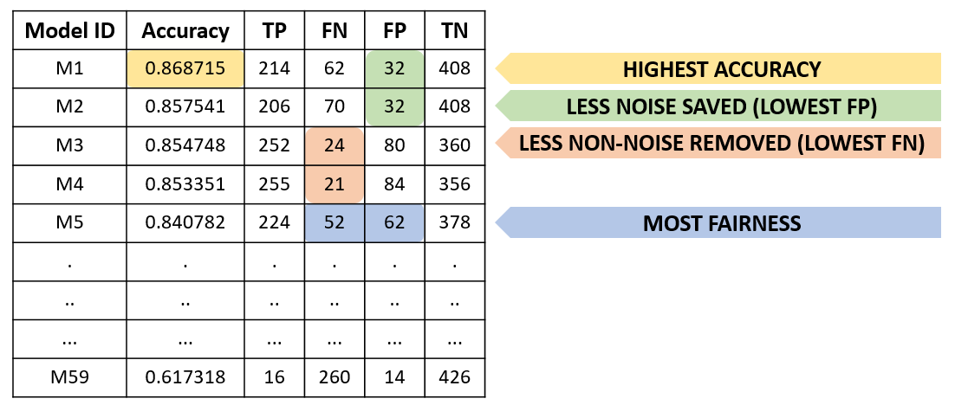


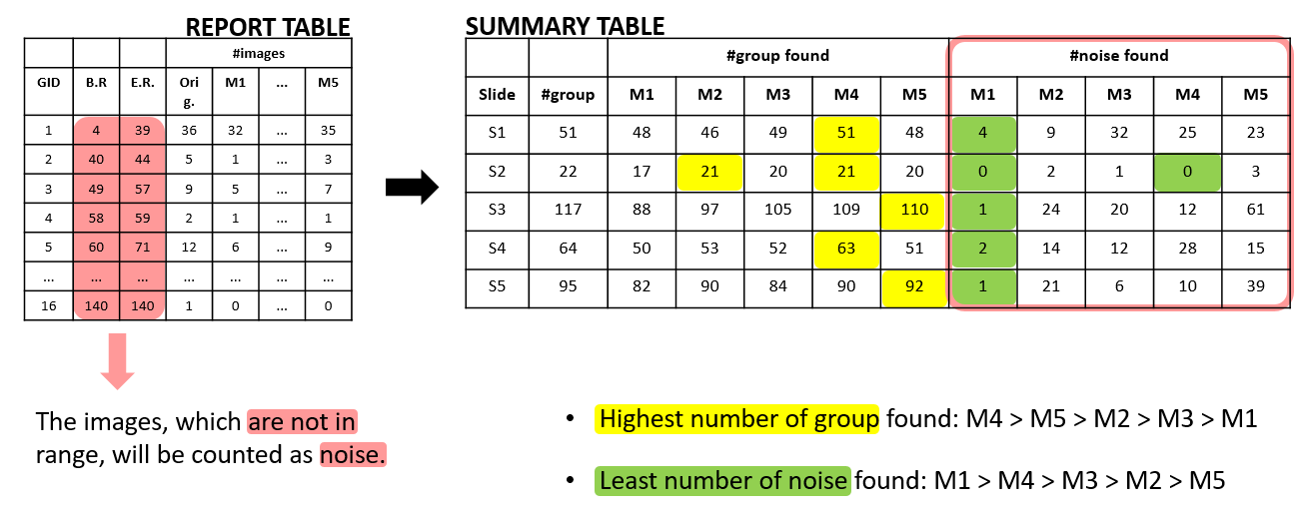


RECAP (1)
BUILT MODEL (59)
SELECTED MODEL (5)
QUALITATIVE-RANKED MODEL (5)

Slide 3
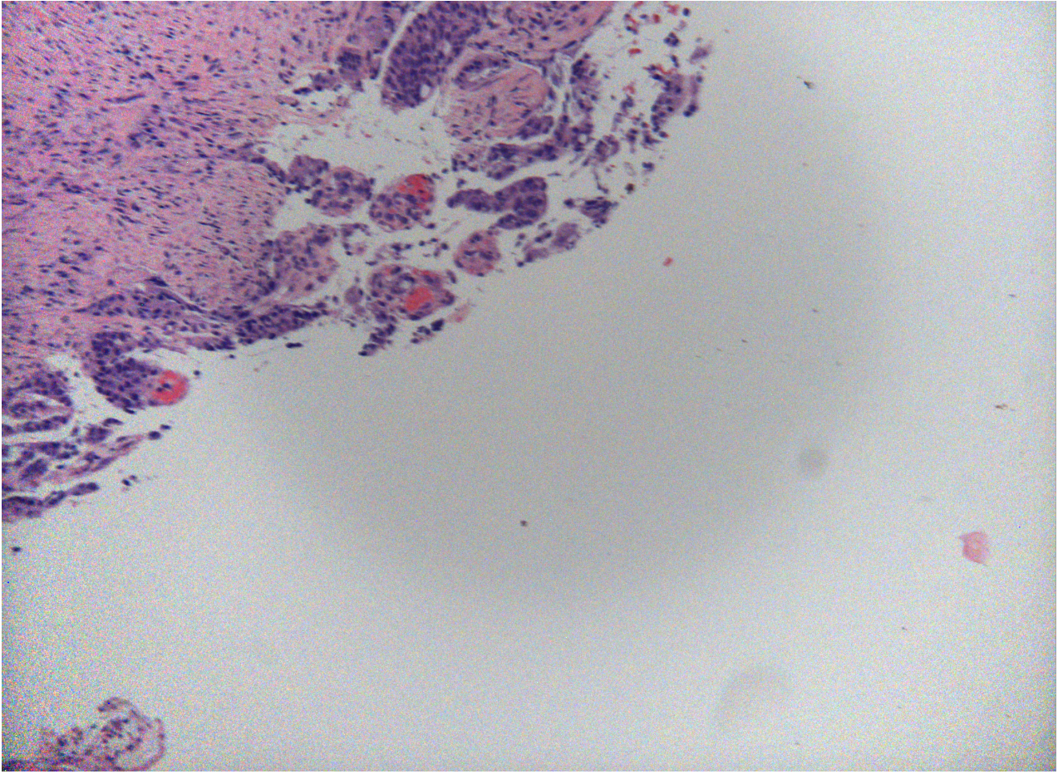
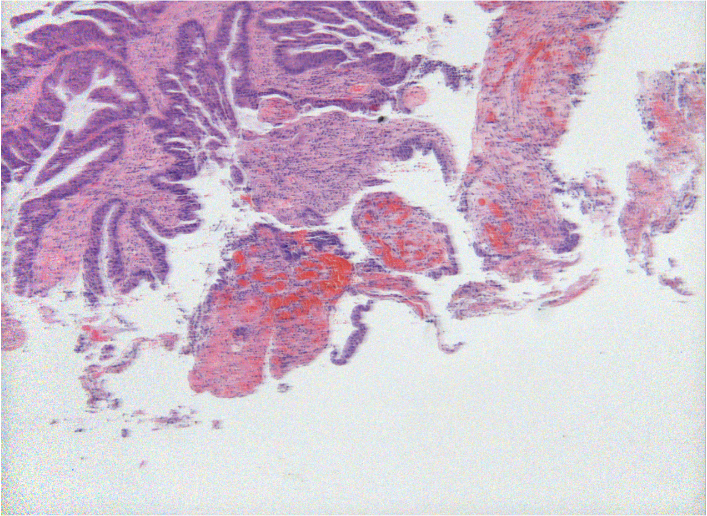
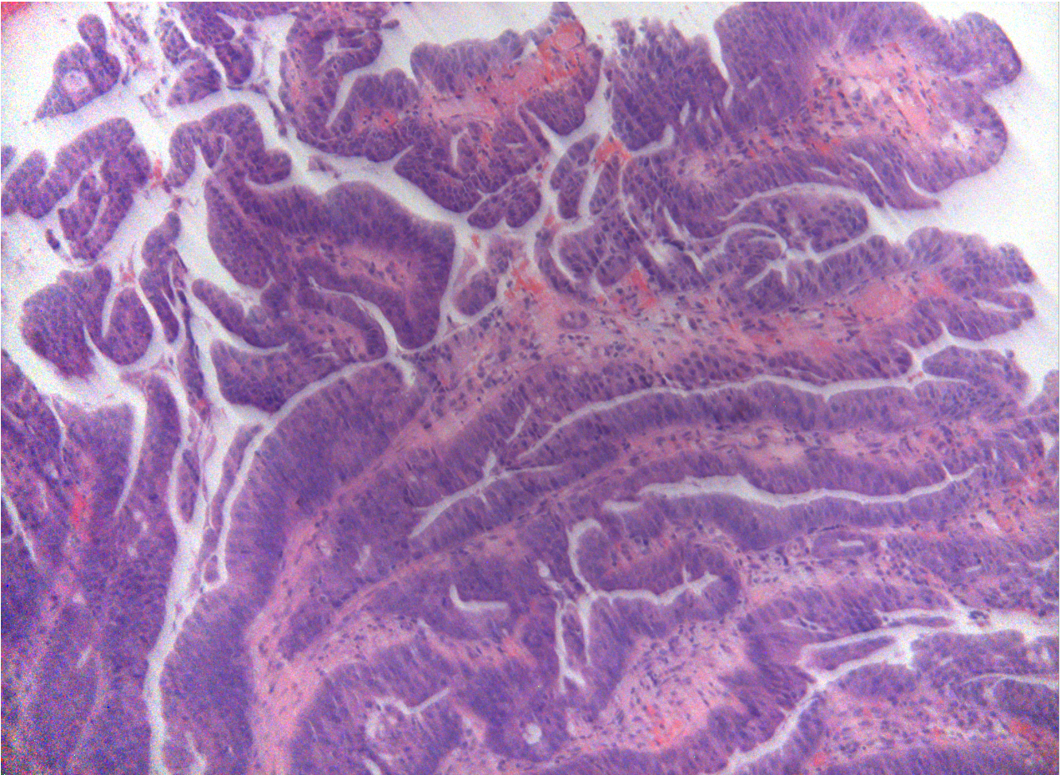
RECAP (2)
Issue
Misclassified NOISE images (1 -> 0)

Slide 4
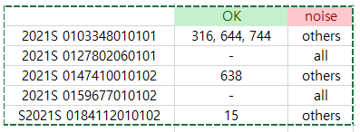
ISSUE 1: Misclassified NOISE images
RESULT TABLE (NOISE)
ACCEPTABLE TABLE
NEW RESULT TABLE (NOISE)
 | M1 | M2 | M3 | M4 | M5
S1 | 4 | 9 | 32 | 25 | 23
S2 | 0 | 2 | 1 | 0 | 3
S3 | 1 | 24 | 20 | 12 | 61
S4 | 2 | 14 | 12 | 28 | 15
S5 | 1 | 21 | 6 | 10 | 39
sum | 8 | 70 | 71 | 75 | 141
 | M1 | M2 | M3 | M4 | M5
S1 | 3 | 3 | 3 | 3 | 3
S2 | 0 | 0 | 0 | 0 | 0
S3 | 0 | 0 | 0 | 1 | 1
S4 | 0 | 0 | 0 | 0 | 0
S5 | 0 | 0 | 0 | 1 | 0
sum | 3 | 3 | 3 | 5 | 4
 | M1 | M2 | M3 | M4 | M5
S1 | 1 | 6 | 29 | 22 | 20
S2 | 0 | 2 | 1 | 0 | 3
S3 | 1 | 24 | 20 | 11 | 60
S4 | 2 | 14 | 12 | 28 | 15
S5 | 1 | 21 | 6 | 9 | 39
sum | 5 | 67 | 68 | 70 | 137
-
=

Slide 5
ISSUE 1: Misclassified NOISE images
SUMMARY TABLE
 |  | #group found |  |  |  |  | #noise found |  |  |  |  | #noise found (new)
Slide | #group | M1 | M2 | M3 | M4 | M5 | M1 | M2 | M3 | M4 | M5 | M1 | M2 | M3 | M4 | M5
S1 | 51 | 48 | 46 | 49 | 51 | 48 | 4 | 9 | 32 | 25 | 23 | 1 | 6 | 29 | 22 | 20
S2 | 22 | 17 | 21 | 20 | 21 | 20 | 0 | 2 | 1 | 0 | 3 | 0 | 2 | 1 | 0 | 3
S3 | 117 | 88 | 97 | 105 | 109 | 110 | 1 | 24 | 20 | 12 | 61 | 1 | 24 | 20 | 11 | 60
S4 | 64 | 50 | 53 | 52 | 63 | 51 | 2 | 14 | 12 | 28 | 15 | 2 | 14 | 12 | 28 | 15
S5 | 95 | 82 | 90 | 84 | 90 | 92 | 1 | 21 | 6 | 10 | 39 | 1 | 21 | 6 | 9 | 39
Highest number of group found: M4 > M5 > M2 > M3 > M1
Least number of noise found: M1 > M4 > M3 > M2 > M5

Slide 6
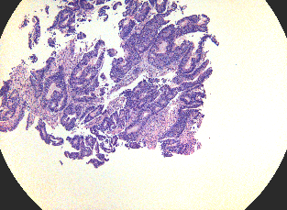
ISSUE 1: Misclassified NOISE images
MODEL
MODEL
Output (softmax)
Argmax(output)
Output (softmax)
0?
Argmax(output)
>th
Result
(0 or 1)
0
1

Slide 7
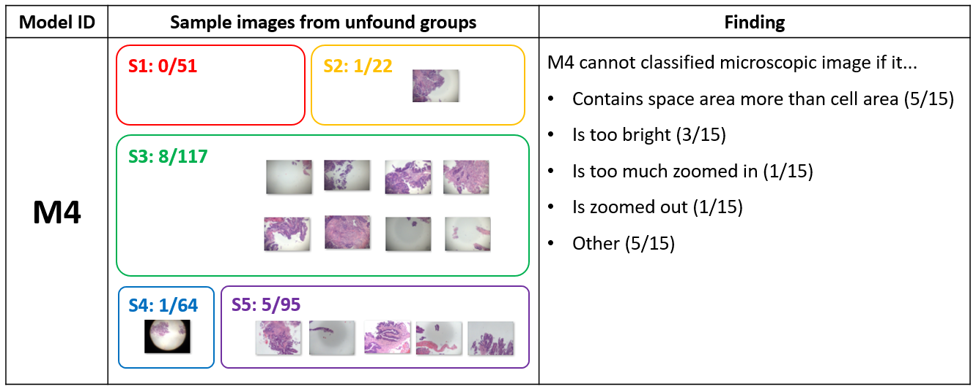
Model 4
 | #group found |  |  |  |  | #misclassified (1->0) found
 | S1 (51) | S2 (22) | S3 (117) | S4 (64) | S5 (95) | S1 | S2 | S3 | S4 | S5
M4 | 51 | 21 | 109 | 63 | 90 | 22 | 0 | 11 | 28 | 9

Slide 8
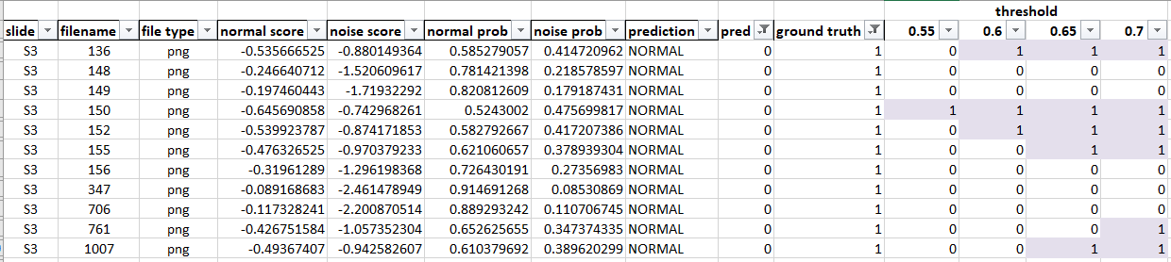
Model 4, Slide 3
=IF(NORMAL_PROB > THRESHOLD, 0, 1)

Slide 9
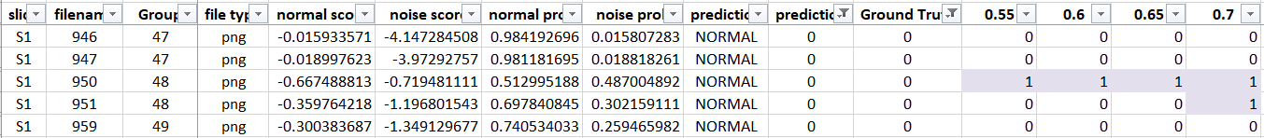
Model 4, all slides
M4 |  | #group found |  |  |  |  | #misclassified (1->0) found
 |  | S1 (51) | S2 (22) | S3 (117) | S4 (64) | S5 (95) | S1 | S2 | S3 | S4 | S5
argmax | argmax | 51 | 21 | 109 | 63 | 90 | 22 | 0 | 11 | 28 | 9
TH | 0.55 | 51 | 21 | 109 | 63 | 89 | 19 | 0 | 10 | 27 | 6
 | 0.60 | 51 | 21 | 109 | 63 | 87 | 15 | 0 | 8 | 23 | 6
 | 0.65 | 51 | 21 | 108 | 63 | 86 | 12 | 0 | 6 | 20 | 6
 | 0.70 | 50 | 21 | 107 | 63 | 86 | 11 | 0 | 5 | 19 | 6
 | … | … | … | … | … | … | … | … | … | … | …
 | 0.90 | 49 | 14 | 92 | 56 | 74 | 6 | 0 | 1 | 8 | 0

Slide 10
To do
Finding optimal threshold for Model 4
[0.6, 0.7]
Logsoftmax vs softmax

